Slide 1
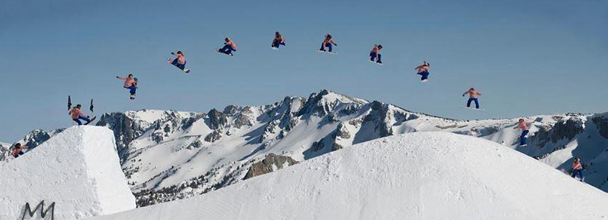
Setting the Scene: Designing Your Problem-Based Classroom
Geoff Krall
gkrall@newtechnetwork
emergentmath.com | @emergentmath
Notes:
[Introduce self, position, context.]
State objective:
To get a basis for transitioning to a 100% Problem-Based environment. [Acknowledge that this may be the beginning of the conversation and more adaptive work needs to occur for yourself, your peers and your students.]
[Also acknowledge the context in which I work: 100% inquiry-based instructional schools. Small schools. Schools with technology.]
I blog at emergentmath.com where you’ll find this presentation and additional resources to develop your problem-based practice.

Slide 2
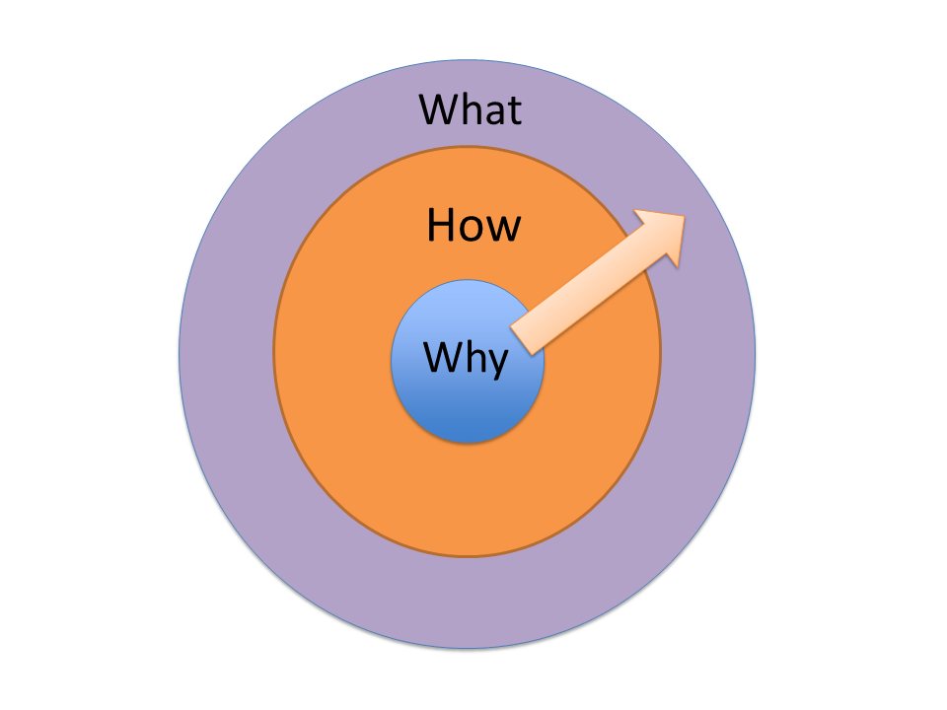
Notes:
We’ll be using this framework for this session. It’s taken from Simon Sinek’s “Start with the why”.
When you’ve ingrained the “why,” the “how” and “what” will be able to come naturally and persistently. Moreover, the “why” gives you a target, or “north star” while you figure out how to best do the stuff around the margins.

Slide 3
Examining Why: Block Party Protocol
Select a quote at random and reflect on its meaning. (3 minutes)
Mingle and share quotes in pairs or triads. (10 minutes)
  Try to have at least three minglings.
Notes:
To examine the “why” we’ll be using a modified version of a block party protocol. A block party protocol is a nice way to examine one or several texts with a group of people. In the protocol, each participant is given a quote from a text at random and reflect upon it’s meaning. Then participants mingle around the room sharing their quote with others and discussing their takeaways from that quote. This is followed by a debrief of the experience and takeaways from the particular conversations.
Consider this the “conference version” of the block party protocol when you’re unsure of the physical space and numbers.

Slide 4
Notes:
Choose one of these four rectangles. Pick one and stick with it. This is part of our modified block party protocol.
[3 minutes]
Now turn to your neighbor (and get up and walk around – depending on the space) and share your quote with that person (don’t worry, I’ll leave these up – you don’t have to memorize).

Slide 5
To help students become successful problem solvers, teachers must accept that students’ problem-solving abilities often develop slowly, thereby requiring long-term, sustained attention to making problem solving an integral part of the mathematics program. Moreover, teachers must develop a problem-solving culture in classroom to make problem solving a regular and consistent part of one’s classroom practice.
“Starting with challenging problems, teachers send the message that all students can engage with difficult content especially when they have each other as resources… Starting with the easy stuff contributes to inequitable teaching”
Another important barrier to meaningful problem solving experiences is that teachers often remove the challenges of a mathematical task by taking over the thinking and reasoning and telling students how to solve the problem.
Students do think that they “get it” when methods are shown to them on the board and they repeat them lots of times, but there is a huge difference between seeing something that appears to make sense and understanding it well enough to use it a few weeks or days later or in different situations.
Notes:
Stay on that rectangle. Here’s your quote to consider and reflect on for a few minutes. Read it over a few times and reflect on your reaction to it.
[3 minutes]
Now turn to your neighbor (and get up and walk around – depending on the space) and share your quote with that person (don’t worry, I’ll leave these up – you don’t have to memorize).

Slide 6
NCTM Research Brief on Problem Solving
“Strength in Numbers” by Ilana Horn
NCTM Research Brief on Problem Solving
“What’s Math Got To Do With It?” by Jo Boaler
Notes:
Now that you’ve had a chance to discuss these quotes, I’d like to show you the sources of these quotes. Don’t feel like you need to jot these down as I’ll share the resources for this presentation, including this slide deck, on my blog which I’ll revisit at the end.
I hope these source texts give you an inkling to why we would want to fully steep our students in complex tasks throughout a curriculum, consistently.

Slide 7
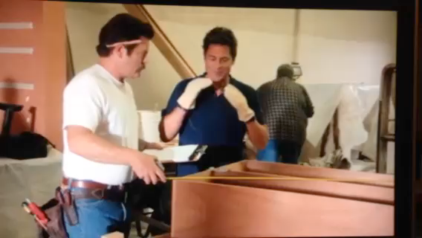
Notes:
Or alternatively, we could let the wisdom of Ron Swanson nee Nick Offerman stand in for our “why”.
[play video]
What Ron says in annoyance we actually believe in earnest. If I may be so bold, I’d suggest my teaching career really began to take off when I came to the operating assumption that … students will not remember a single word I ever say. That may have not been entirely true but that was the assumption I began operating under a few years into my teaching career. And it was quite freeing actually and encouraged me to provide mathematical experiences for students beyond what I demonstrate on the board.
Moreover, consider sharing the “why” with your kids. As you no doubt know, you’ll probably be the first teacher to ever challenge students in this way. Personally, I’d consider posting these quotes up around the room moreso than the “math is everywhere” posters.

Slide 8
Examining How: Problem Based Learning
Instruction
Problems
Notes:
In many ways, a Problem Based environment is incredibly complex with a lot of moving parts. However, in some ways, it’s actually quite simple. Consider this our typical lesson plan. We deliver some sort of instruction, then ask students to reproduce said instruction via a problem set. “All” a PrBL classroom does is this.
[Flip]
Now what we do is give the problem first. If you have a problem set on quadratics, great: give that to students first before they’ve ever heard of quadrics. Allow them to struggle with it for a bit. Then, we’re able to jump in instruction after a while. We’ll get more into the structure of this in a moment. But I just wanted to take a moment to acknowledge that, while a PrBL classroom is incredibly complex, the basic framework is simple the swapping the placement of the task and the instruction. Hopefully this sets your mind at ease when considering a problem-based environment. All those great teaching moves you’ve done for your entire career are still valid and vital. If you like manipulatives, great, if you do technology investigations super. Shoot if you’re a phenomenal lecturer as I wasn’t, keep that in your toolbox. I’m just suggesting that those great teaching moves occur within the context of a problem that students are in the middle of attempting to solve. More on that in a moment.

Slide 9
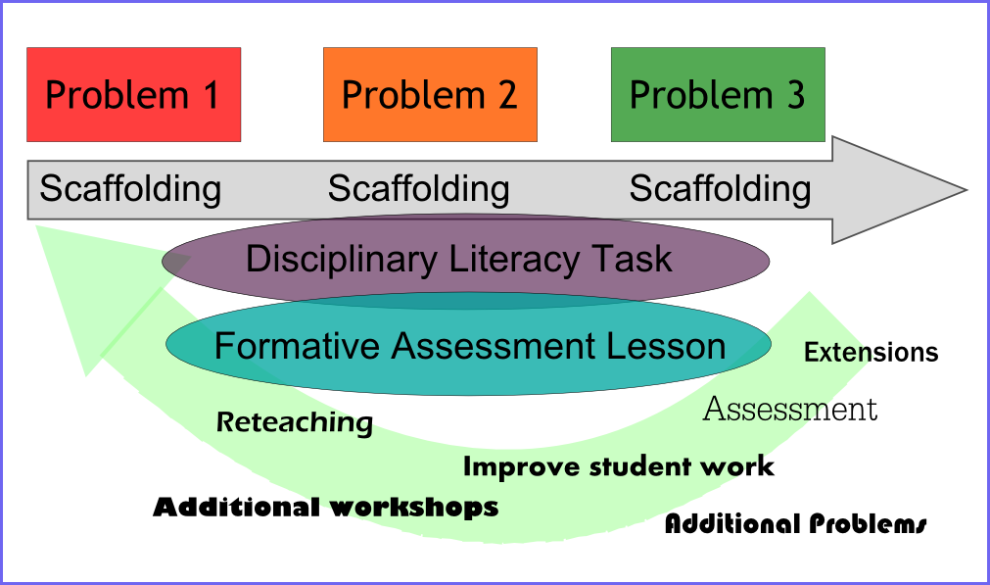
Examining How: Problem Based Learning
Notes:
This is the diagram we’ve been using for our PrBL Units. Every problem is tied to a scaffolding lesson and every scaffolding lesson is tied to a problem. You could consider each problem the next standard in your scope and sequence. After each problem or a few problems, we have the opportunity to change course, depending on how students are doing with the content. As for how long the problem last, I’d say between one-ish day to three-ish days are probably ideal.
In each unit we expect a disciplinary literacy task and a formative assessment lesson, which we won’t get into for this presentation, but are additional things to consider.

Slide 10
Our challenge
How to collaborate
How to strategize
How to problem solve
Confident in their math abilities
Comfortable with productive struggle and failure
Flatten status issues
Notes:
Now I don’t want to paint this picture that a PrBL environment is a silver bullet in and of itself. These are just some of the things you’ll need to address and scaffold.
How to collaborate. Perhaps the biggest mistake PrBL practitioners make – and one that I made – was to assume that students know how to collaborate. I’m not sure what it is. It’s like we see how they interact personally and think “man, they must just be itching to collaborate on math so I don’t have to teach them that skill!” But it’s not like that. When you say “go!” and students begin working on a problem, if you haven’t established and explicitly taught classroom norms, you’ll probably get inequitable groupwork.
How to strategize. Again, you’re probably the first person to ever ask students to problem-solve in this way. How to do this will have to be scaffolded just like your math content. I’ll provide a protocol that I often use that helps establish that persistent problem solving culture.
Students are not inherently confident in their math abilities and they are definitely not cool with failure and productive struggle, because that’s what we’ve taught them vis a vis punative grades that assess on correctness for a decade. Students have been conditioned to not take risks.
And lastly, we must flatten status issues in the classroom. Kids think that some kids are smart, others are not and we have to communicate different ways of being smart in math. To that I’d recommend a few other sessions at this conference that address this critical issue.
So yeah, there are a lot of challenges with a PrBL Classroom. And – for better or worse, hopefully better – a PrBL classroom will tend to bubble up these issues sooner than in a traditional classroom. If kids aren’t adept at collaborating, strategizing, or aren’t confident in their abilities, that can easily be masked in a traditional classroom focused on reproduction of steps. Then again…. As I look at this list, I mean: isn’t this the true value of math instruction? To me, this is exactly what I want students to learn to do in my math classroom. So I want a classroom that addresses these issues head on.

Slide 11
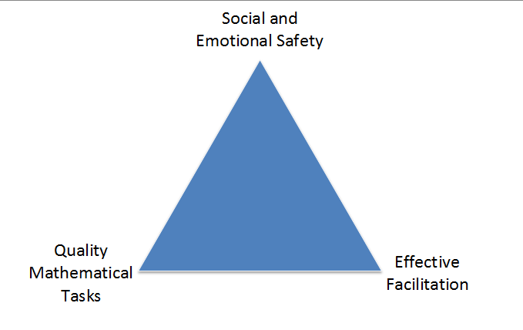
Preconditions for success in a Problem Based Classroom
Notes:
To that end, I’d suggest that you need three things for a PrBL Classroom to be successful.
This session will henceforth be focused on the tasks, but I hope I’ve impressed the critical nature of the other two vertices of this triangle.

Slide 12
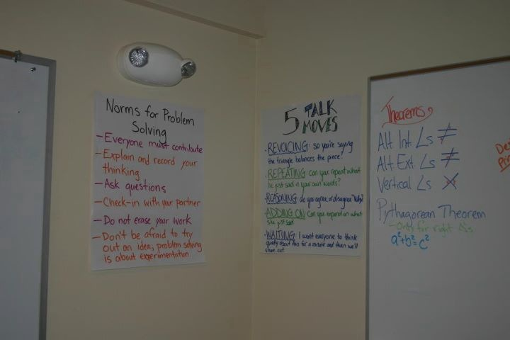
Notes:
One critical move suggested by research is the establishment, teaching, and revisiting of classroom norms. Norms are a way of acting and interacting and just like content, they become more ingrained the more they are discussed and taught.

Slide 13
NCTM’s “Worthwhile Problem Criteria” (a selection)
creates an opportunity for the teacher to assess what his or her students are learning and where they are experiencing difficulty
can be approached by students in multiple ways using different solution strategies
has various solutions or allows different decisions or positions to be taken and defended
encourages student engagement and discourse
Notes:
What makes a quality problem? Well thankfully NCTM in the aforementioned research brief provides a “worthwhile problem criteria”. The brief provides 10 criteria but I’d like to focus on these four as we examine a few tasks. Frankly some of the criteria are a little soft on content or perhaps too broad to use in analysis. These four that I’ve selected I feel embody the real shift from a classroom where problem solving is sort of hinted at and one where the curriculum, start-to-finish is bent on problem solving.

Slide 14

Notes:
[video acting funny. Check it out]

Slide 15
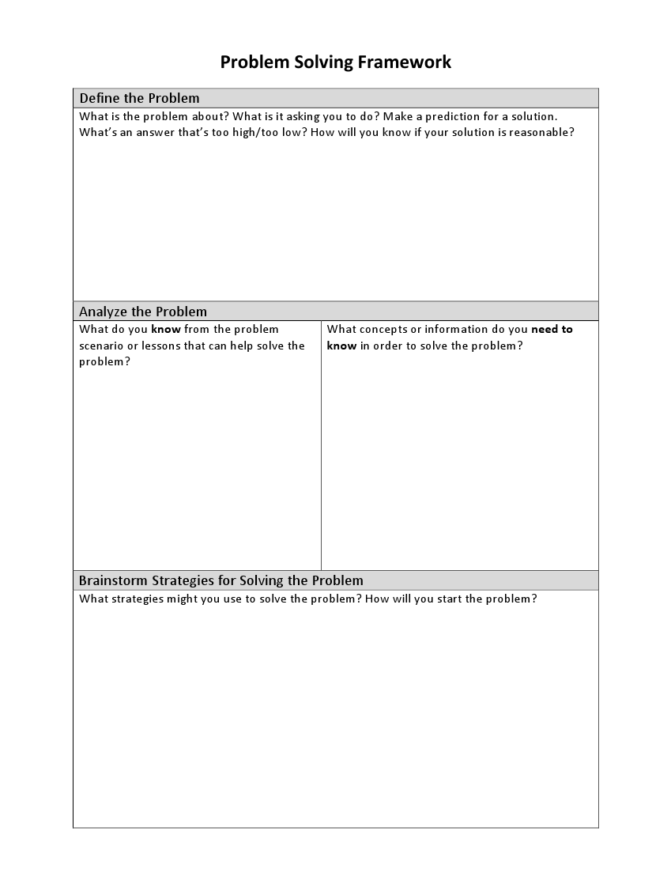
Provide students an oft-used protocol.
Here’s mine.
Know/Need-to-Know/Next-Steps
Notes:
So here’s the start of the protocol we use. And I’d start by suggesting that a protocol becomes more useful with repetitive use. You know how I mentioned that students aren’t adept at problem solving, which is the whole point of this? Make sure to give them a tool that they become familiar with the begin that process. It doesn’t have to be this one but this is one that I’ve found successful. It’s called the Know/Need to Know Process.
First, students are asked to define the problem. Maybe it’ll incorporate some sort of prediction, maybe a shoutout to reasonableness. This is followed by Know’s and Need-to-Knows. Basically, what do students know about the problem, what’s the important information, what’s the prior knowledge that might help them out. Then, the need-to-knows. What information or mathematical stuff will you need to know in order to solve this problem. So I’ll toss this image back up and just take a few minutes to talk to your neighbor and discuss what information will you need to know in order to solve this problem.
[5 minutes]
Alright so at this point in my class I’d facilitate and “massage” the need to knows as a whole class to make sure we got ones that were appropriate for the standard I’m trying to teach. In this case, the lesson was intended to be on building functions to create a system of equation. Like I said this is an Algebra 1 class. Hopefully y’all put down something about the number of trips I’d have to make. Or the amount of stuff we have to move. Maybe you talked about how much gas it’d cost. This is great. You’re now asking me for the pertinent information to solve this problem, and eventually the acutal math in order to solve it.
And before I move on, I’m guessing that a few of y’all threw out something about Pythagorean’s Theorem. We’ve got a right triangle after all and some kids have that alarm in their brain that says every time there’s a right triangle, Pythagorus can’t be far behind. But others may not. So now that I’ve collected these sheets, and we’ve discussed this as a class, I have a perfect opportunity to decide if I need to hold a small workshop around Pythagorean’s theorem. This protocol naturally differentiates.
Let’s take a look at another entry event.

Slide 16
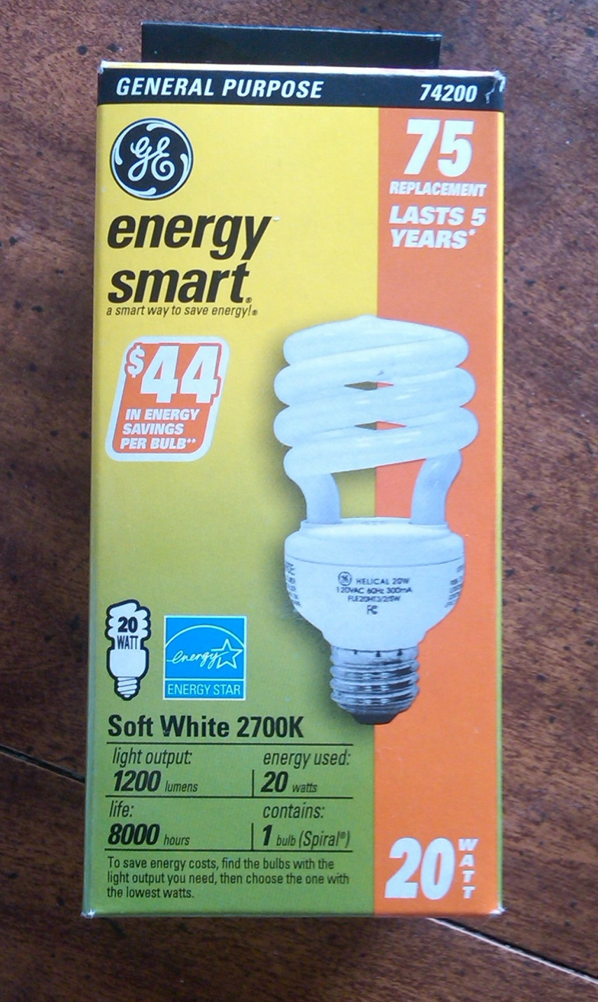
How much will you save by using this light bulb instead of an incandescent one?
How long before it pays itself off?
Notes:
[Take a moment]
This problem doesn’t require video editing or much in terms of multimedia other than taking a photo.
This packaging is ripe for the K/NTK process. There are data, claims, and summation of knowledge that can be identifyed and possibly challenged. Again, a systems-ish problem. This is similar content, but posed in a different way, according to your preference, or possibly one-after-the-other. This light bulb is more expensive initially, but uses less energy. Incandescent bulbs use more energy but are way cheaper.
Whether it comes at the beginning using the K/NTK process or 30 minutes into student working on the problem, they’’ll be asking “how do you find the intersection of these two lines?” By posing the problem BEFORE the instruction, you’ve suddenly become the hero! You can save the day and teach them “THIS IS CALLED A SYSTEM OF EQUATIONS AND THIS IS HOW YOU CAN SOLVE THEM.”
Let’s look at one more, again in video form.

Slide 17

What: the tasks & initiating the inquiry
Notes:
Ideally, it’d be fantastic if you could pose problems without having to ask a question. With carefully crafted – yet inexpensive or, in this case, free - video editing software, you can create an artifact that may get students asking the question.

Slide 18
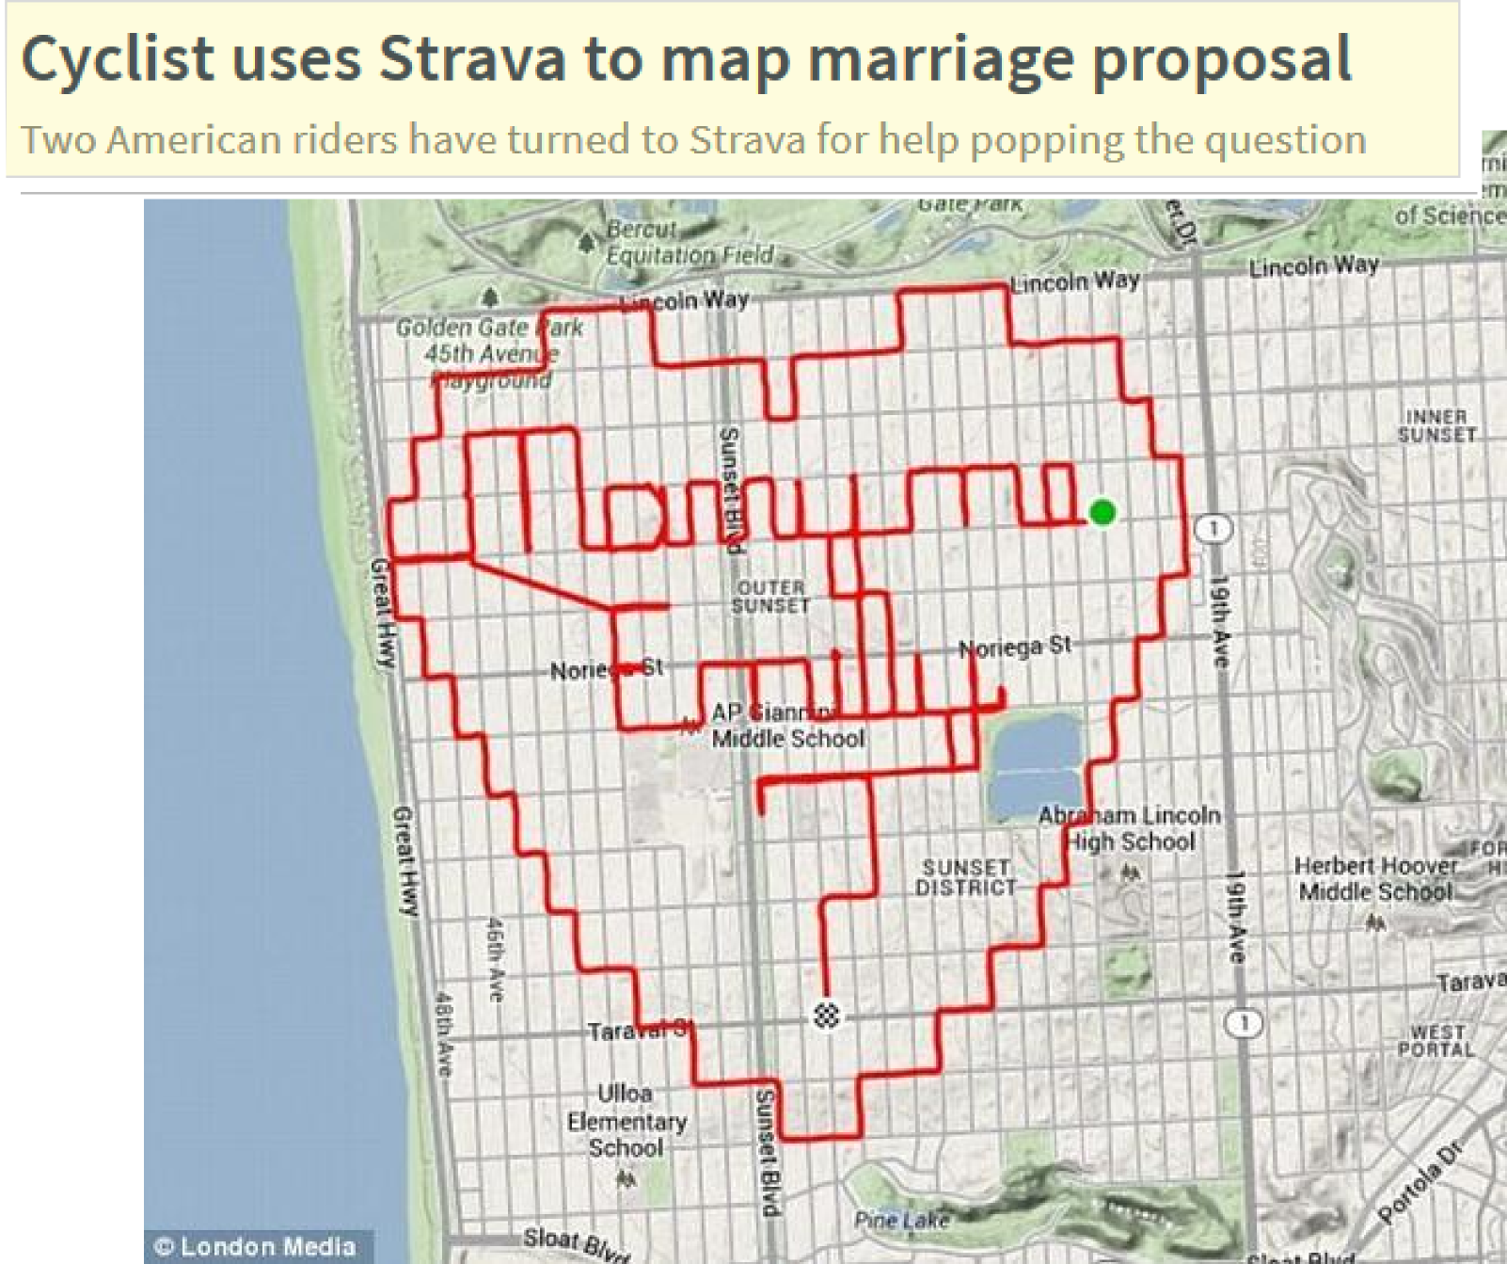
Notes:
You’ll discover that after a little while you’ll start to develop a sort of “problem radar”. You’ll always be in problem finding mode. You’ll see something on TV or in the newspaper and think “this’d be great to incorporate into my class.” It’s kind of fun.

Slide 19

Start with the Math
Think about applied scenarios.
Try to add some “drama.”
Predict what student Need-to-Knows will be.
Design the scaffolding and instruction.
Problems
Find and pose problems that are compelling to you.
Notes:
So how do you design problems. Unfortunately, this is something we simply don’t have time for in a one hour session, but here are some quick tips to get you started.
Start with the math. What’s the standard or cluster of standards you’re trying to address.
Think about applied scenarios. This is usually the first place I turn: when do I actually encounter this math in an actual real live scenario? Because that could contribute to the crafting of the entry event. Applied scenarios aren’t the end-all-be-all, but to me are the most compelling and frankly the easiest way to start.
Try to add some drama. The squirrel video attempted to leave viewers in suspense so kids wanted to know how it ended. Or want to know how to solve the task.
Predict what student NTK’s will be. And design the scaffolding and instruction. Again, this is the stuff you’ve always done, but now it’s in assistance of students solving a larger problem.
And lastly, find problems that are compelling to you. Maybe the most important thing you can do as a math teacher is model that excitement and curiosity. Even if it’s a dumb little video of a guy racing another guy in a squirrel costume, if it’s clever, if it’s novel, if it’s funny to you, it probably will be for your students as well.

Slide 20
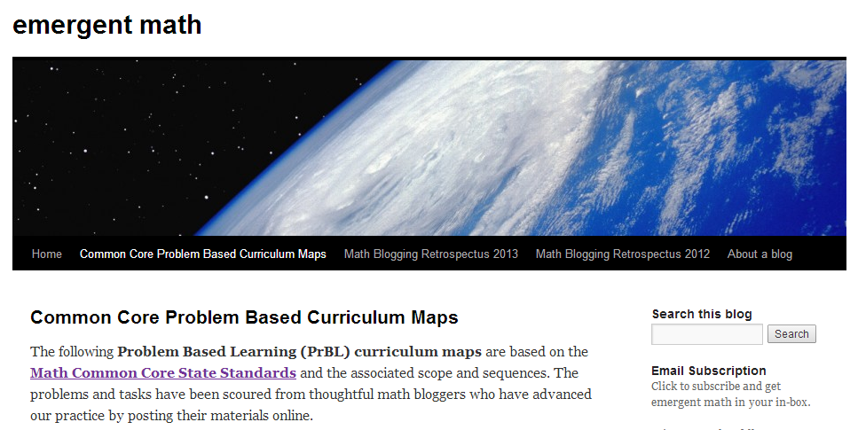
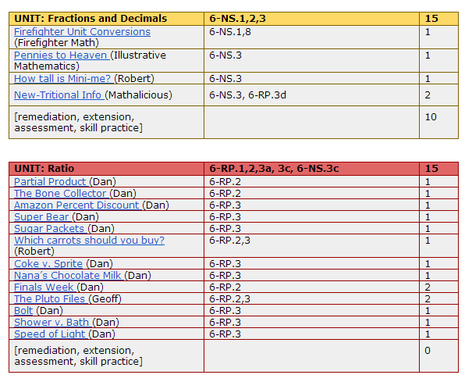
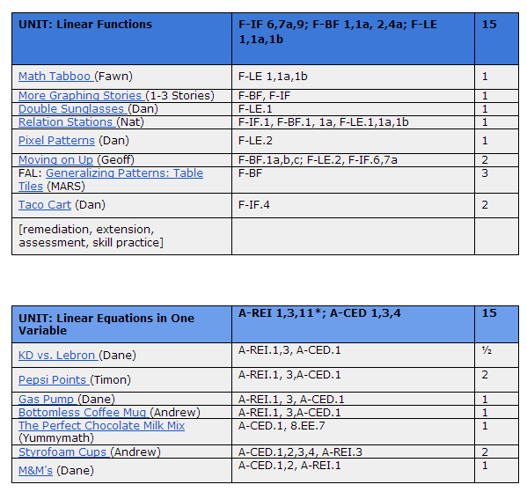
Notes:
Zooming out one more level, we attempt to build our curriculum via a PrBL Classroom. I’ve attempted to do just that on my blog using stuff that’s been freely posted around the web.

Slide 21
Setting the Scene: Designing Your Problem-Based Classroom
Geoff Krall
gkrall@newtechnetwork
emergentmath.com | @emergentmath
Notes:
Once again, this presentation, including links to resources, tasks, and these curriculum maps can be found on my website emergentmath.com where I often consider implications of a PrBL classroom. We’ve only scratched the surface, and there is so much more to consider: assessment, scaffolding, managing groups, just to name a few. But I hope I’ve at least laid some groundwork for you to explore further.
You can find me hanging out online via my email address, blog, and twitter account.
Thanks.

